Slide 1
Three-Tier Architecture
Group 1

Slide 2
Contents
What is Three-Tier Architecture
Presentation Tier
Application Tier
Data Tier
Benefits of 3-Tier Architecture
Disadvantages of 3-Tier Architecture
Diagram
References

Slide 3
What is Three-Tier Architecture?
A Software Architecture that organizes applications into three logical and physical computing tiers.
Presentation tier
Application tier
Data tier
Because each tier runs on its own infrastructure, each tier can be developed simultaneously by a separate development team, and can be updated or scaled as needed without impacting the other tiers.

Slide 4
Presentation Tier
The User Interface.
Communication between the user and the application.
It’s purpose is to present information to and gather information from the user.
Can run on a web browser, desktop application or graphical user interface (gui).

Slide 5
Application Tier
The logic tier, or middle tier, heart of the application.
Where the information gathered from the presentation tier is processed using business logic.
Can also add, edit or delete data from the data tier.

Slide 6
Data Tier
Database tier, data access tier or backend.
Where the information processed in the application tier is stored and managed.
Can be done in a relational database management system, or in a NoSQL database server.

Slide 7
Benefits of 3-tier architecture
Each tier can run on a separate OS and server platform that best fits its functional requirements.
Services of each tier can be customized and optimized without impacting the other tiers.
Faster development - different teams can work on different tiers.
Improved scalability - any tier can be scaled independently as needed.
Improved reliability - An outage is less likely to impact the availability or performance of the other tiers.
Improved security - A well designed application tier can function as an internal firewall, since the presentation tier and the data tier do not communicate with each other.

Slide 8
Disadvantages of 3-tier architecture
More complex structure.
More difficult to setup and maintain.
The separation between business logic and databases may affect performance.

Slide 9
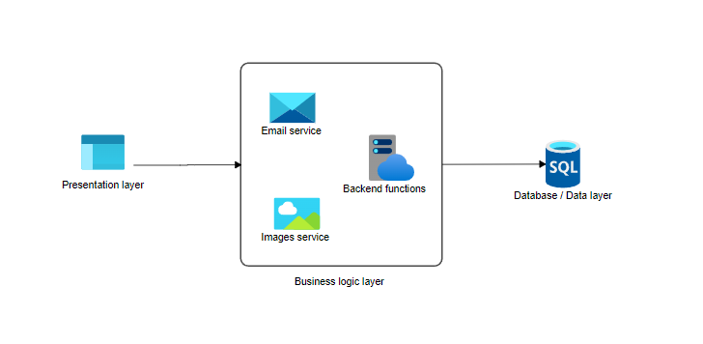
Diagram

Slide 10
References
AWS. (2021). AWS Serverless Multi-Tier Architectures with Amazon API Gateway and AWS Lambda AWS Whitepaper. Retrieved from Amazon AWS Docs: https://docs.aws.amazon.com/whitepapers/latest/serverless-multi-tier-architectures-api-gateway-lambda/serverless-multi-tier-architectures-api-gateway-lambda.pdf#three-tier-architecture-overview
IBM. (2020, October 28). Three-Tier Architecture. Retrieved from https://www.ibm.com/cloud/learn/three-tier-architecture
Kambalyal, C. (n.d.). 3-Tier Architecture. Retrieved from https://channukambalyal.tripod.com/NTierArchitecture.pdf

